Slide 1
Coffee Shop
Sales
Analysis
Mai Nguyen Xuan Kieu
kieumnx@gmail.com

Slide 2
Table of Contents
01
About Dataset
02
Processing
03
Analysis
04
Summary
05
Proposal

Slide 3

About Dataset

Slide 4
About Dataset
1. Source
Kaggle: Coffee Shop Sales Analysis
2. Data content
This dataset contains the sales data of a coffee shop
Period: Jan 01, 2023 - Jun 30, 2023
3. Num of Columns: 18
transaction id, transaction date, transaction time, store id, store location, product id, transaction quantity, unit price, total bill, product category and many others

Slide 5
Processing

Slide 6



Tools

Slide 7
Processing Steps
1. Check quality data and change data type
Change data type of column transaction_date
Remove duplicates
2. Create data model
Split dataset into multiple tables: orders and order_items
Create a new table: dim_date
3. Add column category_type into order_items in 4 groups
Ingredients
Finished Products
Complementary Products
Branded
4. Replace values Size for some product_id
5. Find bundled products
Define a function BundledProducts()
Using combinations function in Python
Finding TOP 3 bundled products or something like that

Slide 8
Analysis

Slide 9
Overview

Slide 10
In the first 6 months of the year
Total Revenue is
$698.81 K
With
116.79 K
$214 K
AND
Total Orders
Total Sales
13.56 %
AVG Revenue Growth Rate

Slide 11
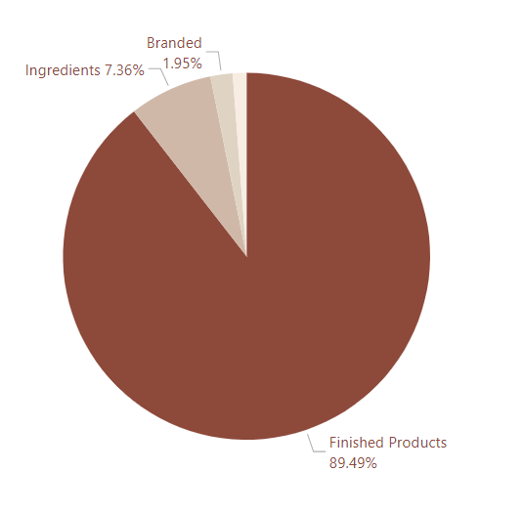
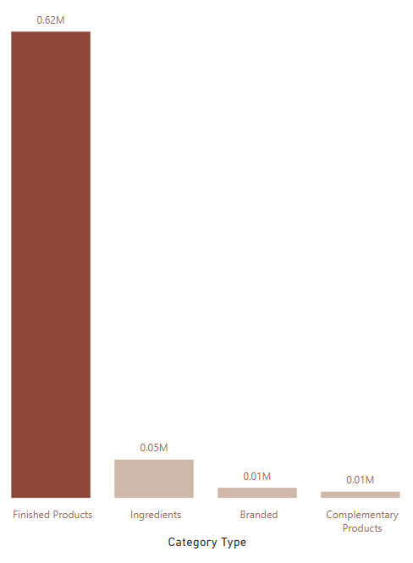
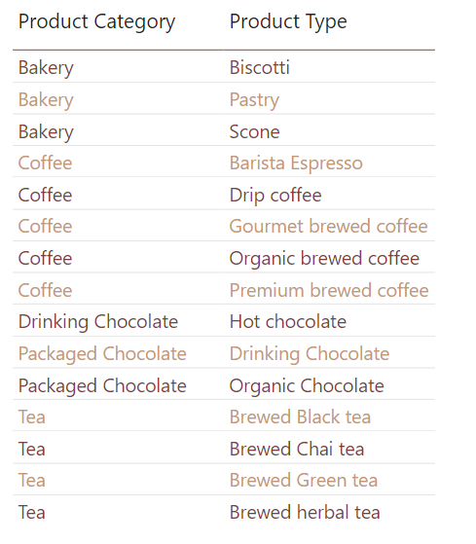
$6.38
Total Revenue By Category Type
Average Order Values
Finished Products has highest revenue with more than $0.62 million
Other category types have pretty low revenue, just take 10% of grand total

Slide 12
Detail

Slide 13
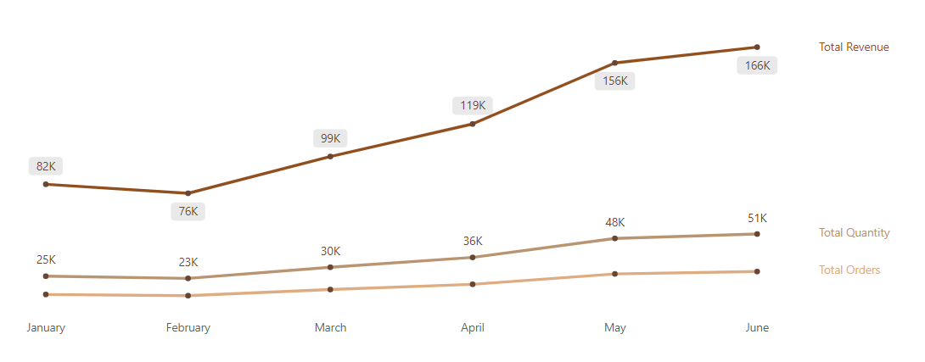
Time
Total revenue, total quantity and total orders are tend to increase in the first half 2023
Everything are tend to decreased in February and gradually increased in the following months
Revenue increased quite rapidly from March to June
On the contrary, sales and number of orders increased quite slowly. This can be seen from the slope of two the line

Slide 14
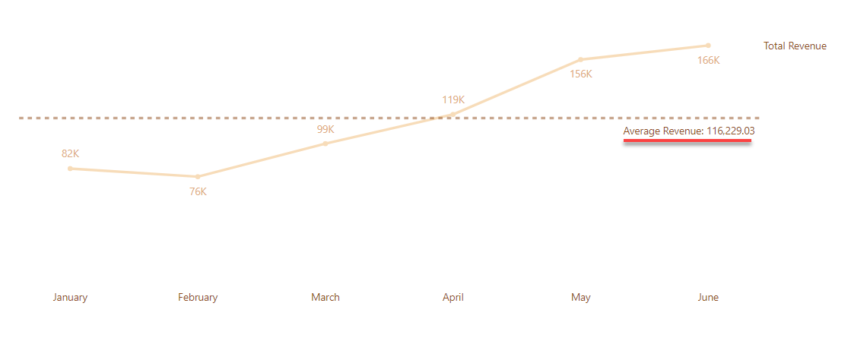
Time
Average Revenue is greater than $116K
First 3 months of the year, total revenue increased quite slowly and total revenue each month less than average revenue
Meanwhile, revenue increased rapidly in the second quarter and was higher than average revenue

Slide 15
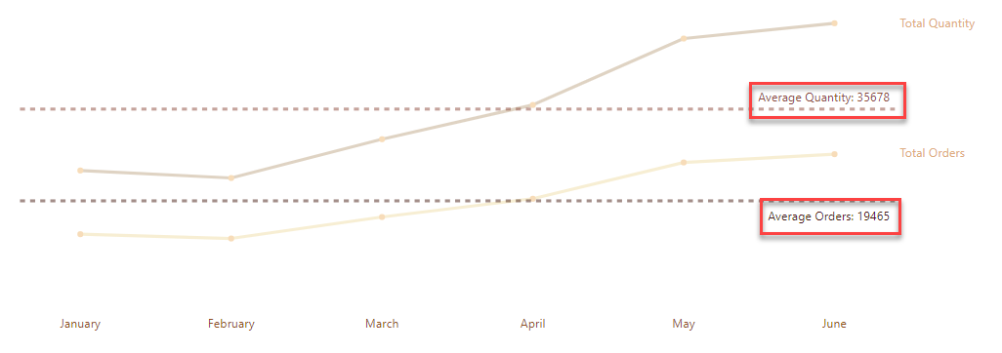
Time
Same Total Revenue
First 3 months of the year, total quantity and total orders increased quite slowly and total revenue each month less than average
Meanwhile, total quantity and total orders increased rapidly in the second quarter and was higher than average

Slide 16
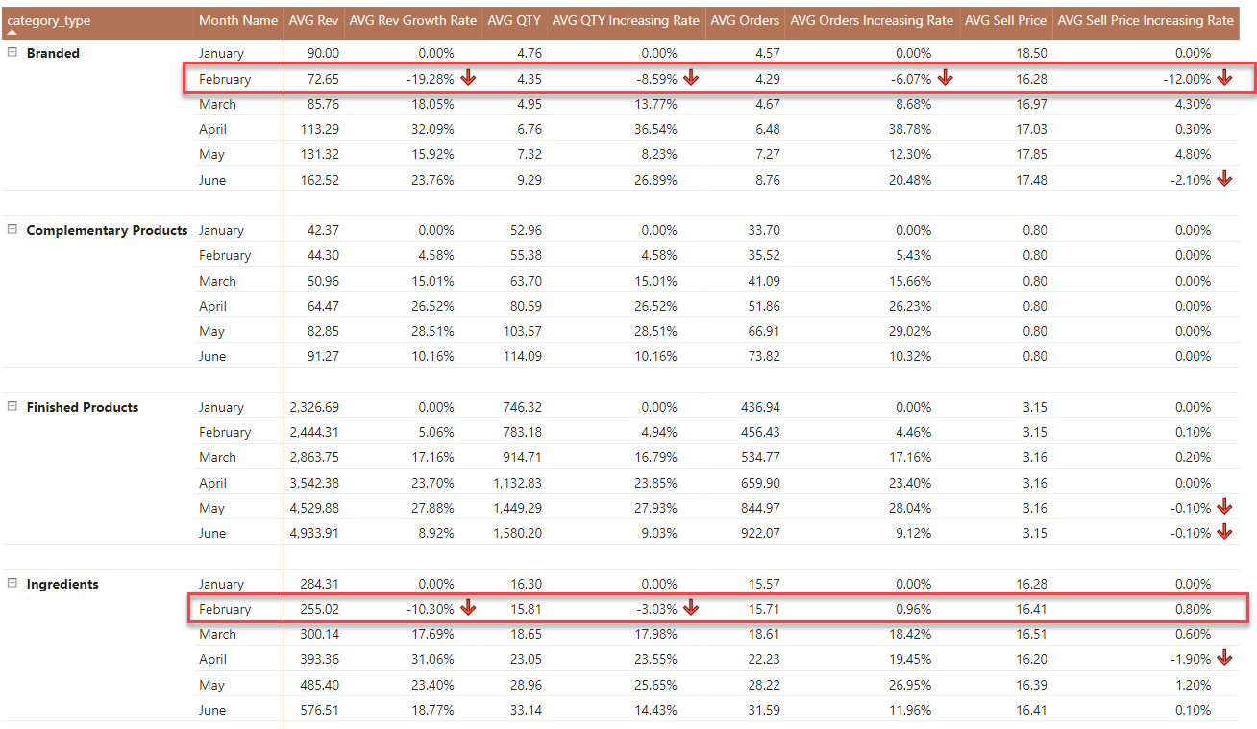
Time
Why do total revenue, total quantity, total orders decrease at February?
All metrics of Branded decrease on February
Average revenue and average quantity increasing rate of Ingredients decrease

Slide 17
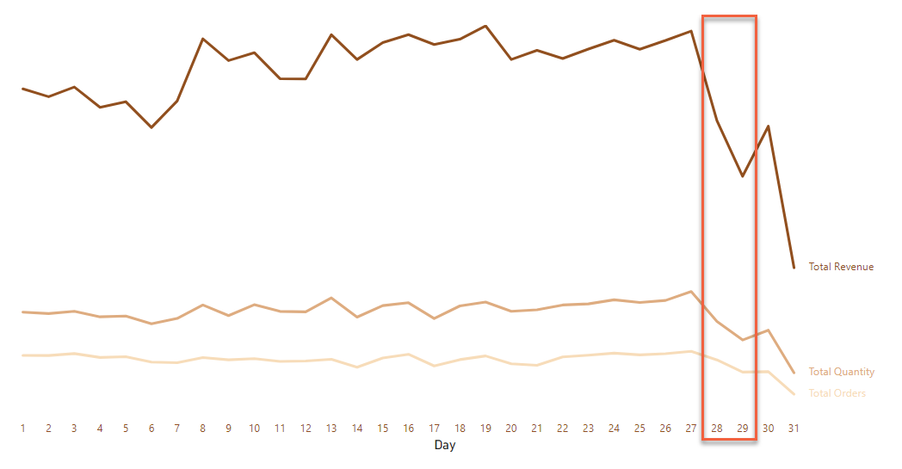
Time
Stable business situation
Total revenue, total quantity and total orders tend to decrease from 28th to 29th, then increase to first month (~ 6th) and stable on middle of the month

Slide 18
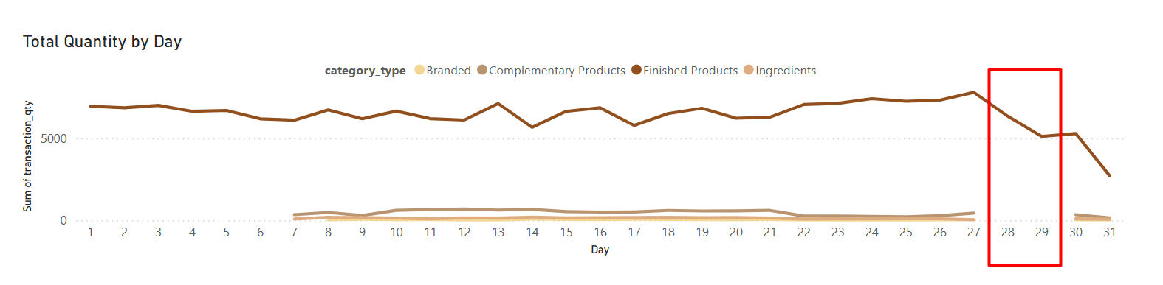
Time
Why do total revenue, total quantity, total orders decrease from 28th to 29th?
Finished Products are bought every day of the month. The other product groups are usually bought from the 7th to the 27th, then again on the 30th and 31st. However, their percentage of revenue, sales, and transactions is small, so they do not really affect the drop on the 28th and 29th.

Slide 19
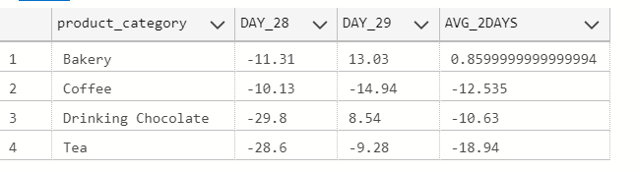
Time
Most categories in Finished Products have lower sales, causing a drop on the 28th to 29th?
The average sales growth in two days for these categories is negative, except for bakery, which has positive growth but not high. This is the reason for the drop on the 28th and 29th.

Slide 20
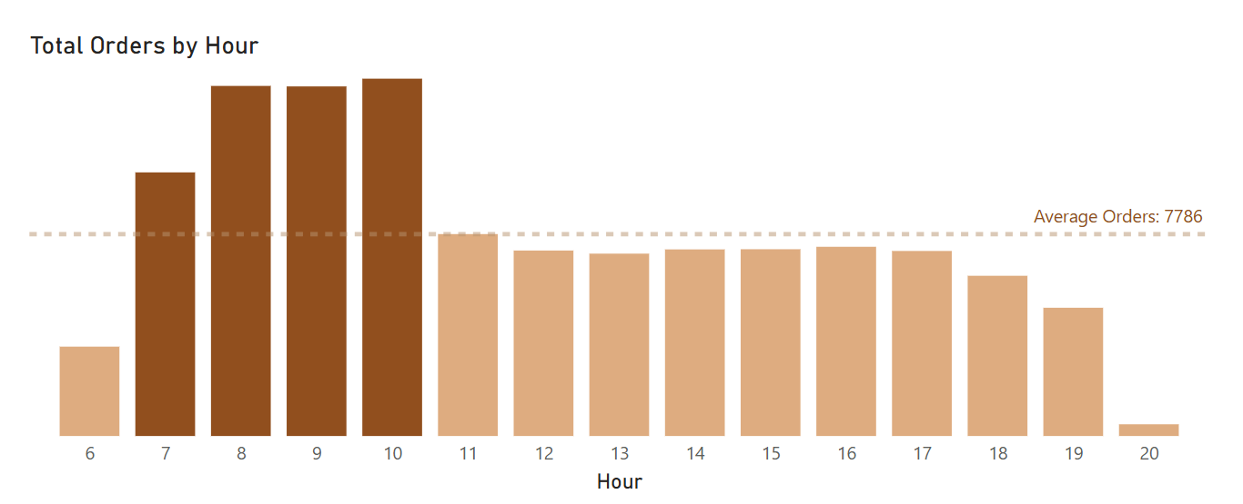
Time
Customers usually buy more in the morning.
Revenue, sales, and orders are higher than average from 7 AM to 10 AM. Except for 6 AM and 8 PM, which are much lower, other time slots are mostly close to the average.

Slide 21
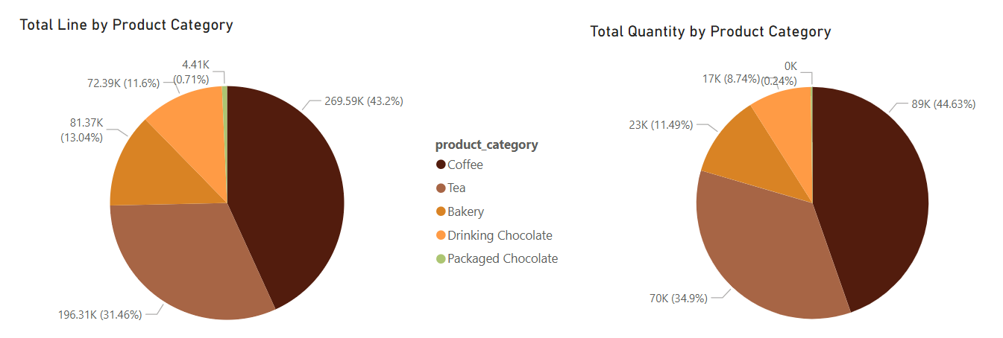
Products
Finished Products group
Coffee and Tea lead in both revenue and quantity, highlighting their strong market performance.
In contrast, Packaged Chocolate contributes slightly less than 1%, likely due to its nature as a bundled product.

Slide 22
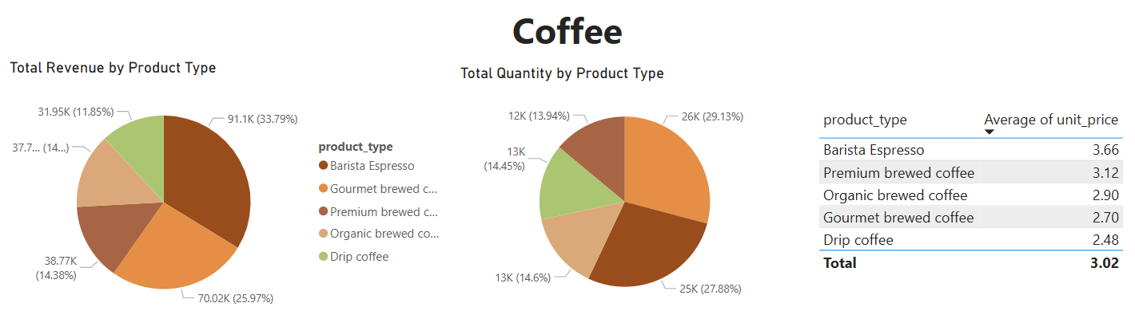
Products
Selling price is a key factor influencing the rankings of most product type within each product category.
Although Barista Espresso and Gourmet Brewed Coffee have similar sales volumes, Barista Espresso leads in total revenue due to its notably higher average unit price.

Slide 23
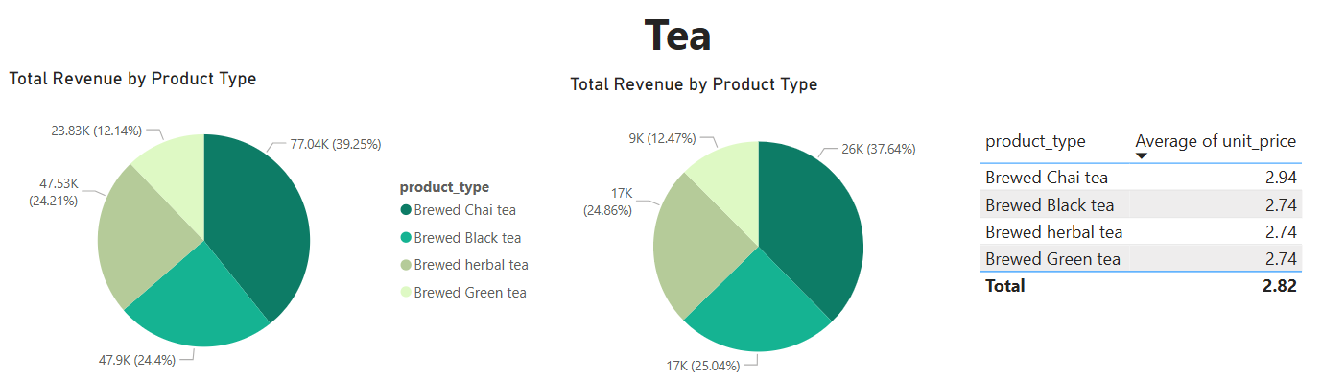
Products
Selling price is a key factor influencing the rankings of most product type within each product category.
Brewed Chai Tea leads in both total revenue and quantity, with average unit prices in the category being relatively consistent.

Slide 24
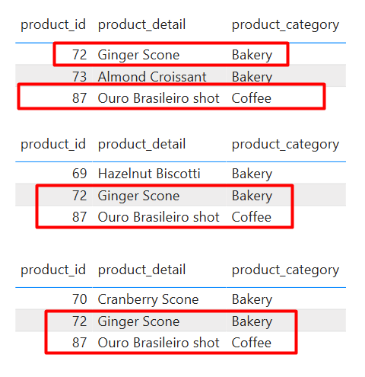
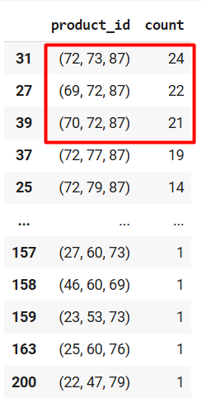
Products
Items in the Finished Products category tend to be bought together
Customers often purchase coffee and bakery items together.
Among these combinations, Ouro Brasileiro Shot and Ginger Scone are the most frequently bought together.

Slide 25
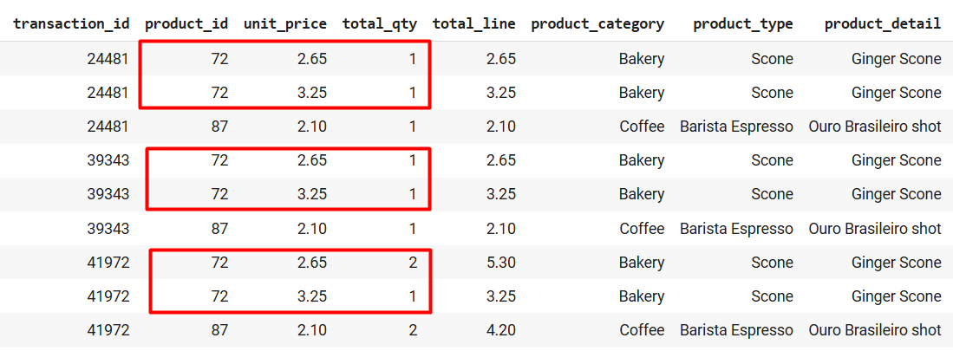
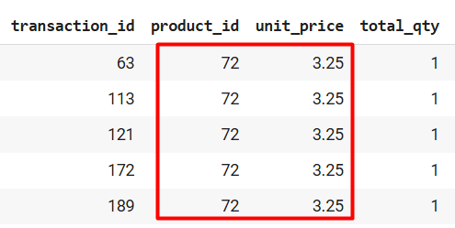
Products
The unit price of Ginger Scone changes when a second item is purchased.
When buying a second Ginger Scone, the unit price drops from $3.25 to $2.65, suggesting a promotional or bundle discount.

Slide 26
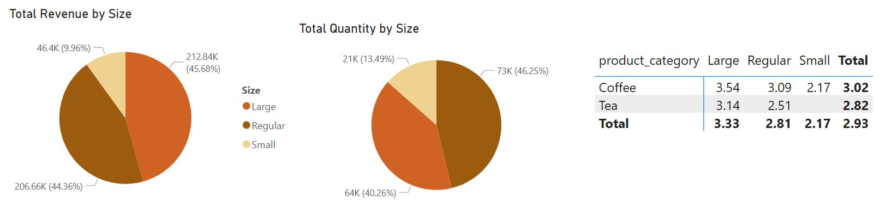
Products
Total revenue and quantity sold of Coffee and Tea, categorized by size
Most customers purchase regular-size drinks, but since the large size has a higher selling price, most of the revenue comes from large-size drinks.

Slide 27
Summary

Slide 28
Summary
Finished Products account for the majority of both total revenue and quantity sold.
Business performance shows an upward trend.
Peak customer hours are from 7:00 AM to 10:00 AM.
Products in the Coffee and Tea categories are frequently purchased.
The average selling price of Coffee products varies significantly, while prices in other categories are relatively consistent.
Coffee and Bakery items are often bought together.
Packaged Chocolate may be an add-on or complementary product.
Sales typically drop on the 28th and 29th, and some products record zero revenue on these days.

Slide 29
Proposal

Slide 30
Proposal
Implement discount programs or special events at the end of the month to boost sales.
Ensure adequate staffing during peak hours.
Launch promotional offers with free add-ons when customers purchase Coffee and Bakery or Tea and Bakery items.
Highlight these categories in marketing campaigns and product placement.
Introduce new seasonal or limited-time coffee/tea items to refresh customer interest.
Offer morning-only combos (e.g., coffee + bakery) to maximize basket size.
Launch end-of-month flash deals or time-limited combos to boost engagement.

Slide 31
Thank You

